Slide 1
SMU Certified Blockchain Developer Course
Project Presentation
On 27th May 2022

Slide 2
Team Members
Lauw Anthony Tenggara
Teo Mei Li
Lee Jia En
Tate Andrea Aung
Liu BaiWei
Low Peng Hu

Slide 3

We are introducing you
NFT Marketplace
Modo Team

Slide 4
SCOPE

Slide 5
SCOPE
Our Team Members
The Project Idea
What is an NFT?
Core Technology Stacks
How does it Works?
How to Build an NFT Marketplace?
Functions of NFT Marketplace
Our Demo
Our Learning Journey
Future Roadmaps
Q & A

Slide 6
Our Team

Slide 7


Frontend Members(UX)
UI/UX
UI/UX
65%
65%
Testing
GitHub
90%
90%
Programming
Programming
70%
70%
Fusce tincidunt eget ligula vitae hendrerit. Phasellus id ligula ut enim elementum bibendum eget eget magna. Fusce in magna diam.
Fusce tincidunt eget ligula vitae hendrerit. Phasellus id ligula ut enim elementum bibendum eget eget magna. Fusce in magna diam.
Andrea Tate
UI/UX Design
Eskaine
UI/UX Design

Slide 8

Backend Members(Smart Contracts)
Smart Contract
Smart Contract
95%
95%
NFT Functions
NFT Functions
90%
90%
Programming
Programming
90%
90%
Fusce tincidunt eget ligula vitae hendrerit. Phasellus id ligula ut enim elementum bibendum eget eget magna. Fusce in magna diam.
Fusce tincidunt eget ligula vitae hendrerit. Phasellus id ligula ut enim elementum bibendum eget eget magna. Fusce in magna diam.
Joyce
Smart Contract Developer
Zachary
Smart Contract Developer

Slide 9

Other Members
Specification
Documentation
65%
65%
Testing
Assets
90%
90%
Deployment
Presentation
70%
90%
Fusce tincidunt eget ligula vitae hendrerit. Phasellus id ligula ut enim elementum bibendum eget eget magna. Fusce in magna diam.
Fusce tincidunt eget ligula vitae hendrerit. Phasellus id ligula ut enim elementum bibendum eget eget magna. Fusce in magna diam.
Antony Lauw
Software Architect & Tester
George Low
Marketing & Documentation

Slide 10
The Project Idea

Slide 11
The Project Idea: NFT Marketplace
1
2
3
Many Interested.
Growing
Huge Revenue
Notes:
Our Project Idea; NFT Marketplace is a promising business. In 2021, the NFT Market grew to $41 billion.
Many people in many countries are very interested in NFTs.
It is a Growing market and will continue to grow in the future.
The 3rd reason is that there is a large amount of money to be made.

Slide 12
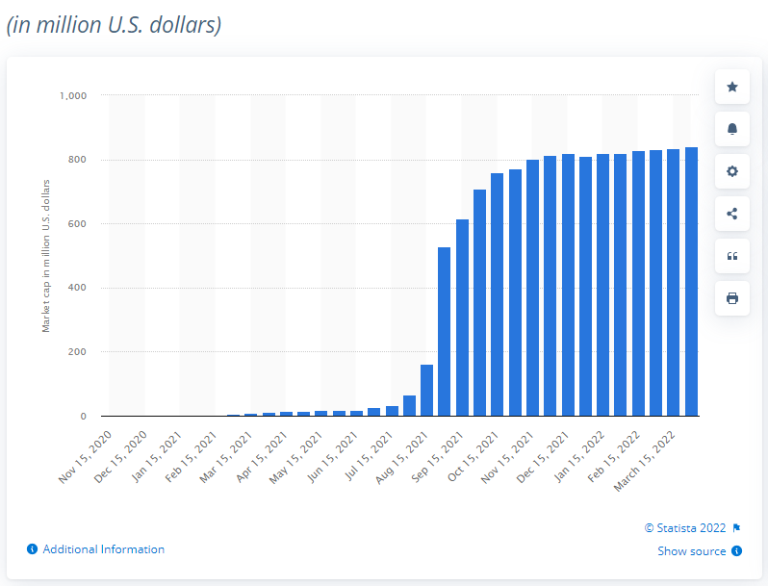
Notes:
Look at the Market Caps for NFT in 2022, we are talking about 840 millions dollars!

Slide 13
What is
an NFT?

Slide 14
A Unique Digital Content associated with a Blockchain
NFT
Non Fungible Token

Slide 15
A Dedicated Platform for Holding & Trading NFTs.
NFT Marketplace

Slide 16



Popular NFT Marketplaces
Notes:
The most well know NFT Marketplaces are Opensea, Rarible and Atomic hub.
Have you tried any of them?

Slide 17
Technology Stacks

Slide 18
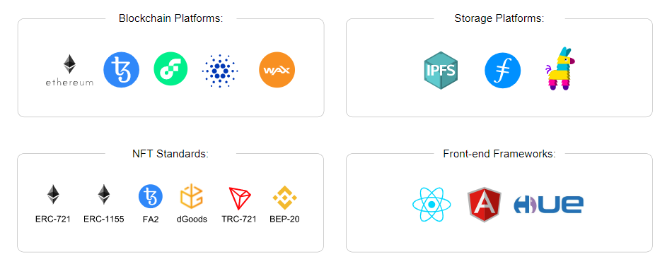

Slide 19
How to does it Work?

Slide 20
1
User Signup
Fund Transfer
10
How NFT Marketplace Works?
2
Wallet Setup
Top Bids Sold
9
3
NFT Creation
Bids
8
4
NFT Config.
Selling List
7
5
List
Moderation
6

Slide 21
How to Build?

Slide 22
6 Steps
Select the Right Blockchain
1
2
UI/UX Design(Audience)
Front-End & Back-End Development
3
4
Select the Base Tokens
Smart Contracts Development.
5
6
Test & Deployment

Slide 23
Functions

Slide 24
Create
List
(Explore)
Transfer
(Bid, Buy)
Notes:
What are the functions of NFT Marketplace then?

Slide 25
Our Learning Journey

Slide 26
Web3
ABI
Learning Journey
Immutable
Libraries
Solidity
ERC-721
Notes:
1

Slide 27

NFT Marketplace
N
Front End
F
12
11
1
Sit back
&
Enjoy
10
2
Tests
T
9
3
8
4
S
7
5
Smart Contracts
6
GitHub
G

Slide 28
Future Roadmaps
B
D
Option
Option
r
r
r
A
C
Option
Option
1
2
3
4
Biding
Collection
Security
Lazy Minting
Notes:
For future features, we consider 4 options:
Biding, Collection, Security and Lazy Minting.
I will focus more on Lazy Minting as this is a relatively new feature amongst other NFT Marketplaces.
Lazy Minting in simple terms means “Minting at the Time of Purchase”
This concept soon became famous among the creators as it allowed them to sell their NFTs without initial investment in gas fees.
Both OpenSea & Rarible have Lazy Minting.

Slide 29
NFT Creator prepares a Cryptographic Signature of some data using their Ethereum Account’s Private Key.
Lazy Minting

Slide 30
You will need an EIP-712 for Hashing & Signing Type Structured Data.
Lazy Minting

Slide 31

Q & A

